Slide 1
I/O device management

Slide 2
Contents
Classification of IO devices, Controllers, Memory Mapped IO, DMA Operation, Interrupts
Goals of IO Software, Handling IO (Programmed IO, Interrupt Driven IO, IO using DMA), IO Software Layers (Interrupt Handlers, Device Drivers)
Disk Formatting (Cylinder Skew, Interleaving, Error handling), RAID
Disk Structure, Disk Scheduling (FCFS, SSTF, SCAN, CSCAN, LOOK, CLOOK)

Slide 3
Introduction
One of the important jobs of an Operating System is to manage various I/O devices including mouse, keyboards, touch pad, disk drives, display adapters, USB devices, Bit-mapped screen, LED, Analog-to-digital converter, On/off switch, network connections, audio I/O, printers etc. An I/O system is required to take an application I/O request and send it to the physical device, then take whatever response comes back from the device and send it to the application.

Slide 4
I/O Devices
I/O devices can be roughly divided into two categories:
block devices and
character devices.
A block device is one that stores information in fixed-size blocks, each one with its own address. Common block sizes range from 512 to 65,536 bytes.
It is possible to read/write each and every block independently in case of block device.
Hard disks, Blu-ray discs, and USB sticks are common block devices.
A character device delivers or accepts a stream of characters, without regard to any block structure.
It is not addressable and does not have any seek operation.
Printers, network interfaces, mice (for pointing), rats (for psychology lab experiments), and most other devices that are not disk-like can be seen as character devices

Slide 5
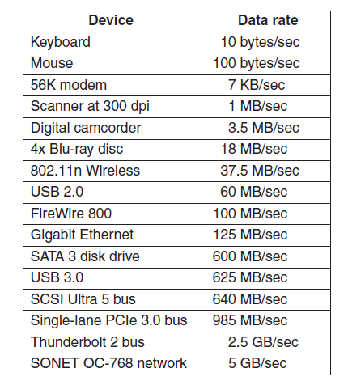
Figure 6-2. Some typical device, network, and bus data rates.

Slide 6
Device Controllers
Device drivers are software modules that can be plugged into an OS to handle a particular device. Operating System takes help from device drivers to handle all I/O devices.
The Device Controller works like an interface between a device and a device driver. I/O units (Keyboard, mouse, printer, etc.) typically consist of a mechanical component and an electronic component where electronic component is called the device controller.
Any device connected to the computer is connected by a plug and socket, and the socket is connected to a device controller. Following is a model for connecting the CPU, memory, controllers, and I/O devices where CPU and device controllers all use a common bus for communication.

Slide 7
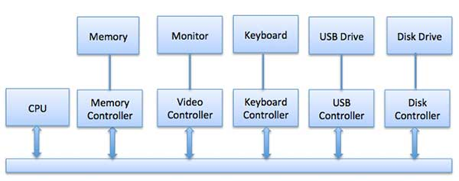

Slide 8
Communication to I/O Devices
The CPU must have a way to pass information to and from an I/O device. There are three approaches available to communicate with the CPU and Device.
Special Instruction I/O
Memory-mapped I/O
Direct memory access (DMA)
Special Instruction I/O: This uses CPU instructions that are specifically made for controlling I/O devices. These instructions typically allow data to be sent to an I/O device or read from an I/O device.

Slide 9
Memory-Mapped I/O
Memory-mapped I/O uses the same address space to address both memory and I/O devices.
The memory and registers of the I/O devices are mapped to (associated with) address values. So when an address is accessed by the CPU, it may refer to a portion of physical RAM, or it can instead refer to memory of the I/O device.
Each controller has a few registers that are used for communicating with the CPU. By writing into these registers, the operating system can command the device to deliver data, accept data, switch itself on or off, or otherwise perform some action.
By reading from these registers, the operating system can learn what the
device’s state is, whether it is prepared to accept a new command, and so on.

Slide 10
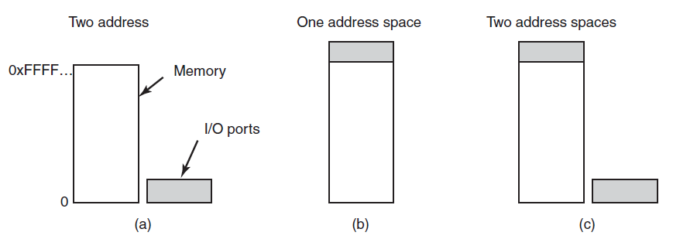
Figure 6-3. (a) Separate I/O and memory space. (b) Memory-mapped I/O. (c) Hybrid.

Slide 11
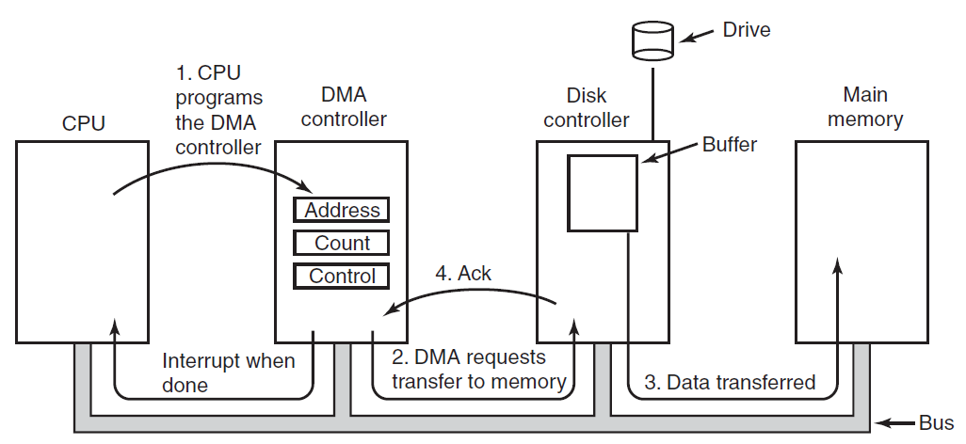
Direct Memory Access
The CPU can request data from an I/O controller one byte at a time, but doing so wastes the CPU’s time, so a different scheme, called DMA (Direct Memory Access) is often used.
Figure 6-5. Operation of a DMA transfer.

Slide 12
The operating system can use only DMA if the hardware has a DMA controller, which most systems do.
Sometimes this controller is integrated into disk controllers and other controllers, but such a design requires a separate DMA controller for each device.
DMA contains several registers that can be written and read by the CPU. These include a memory address register, a byte count register, and one or more control registers.
The control registers specify the I/O port to use, the direction of the transfer (reading from the I/O device or writing to the I/O device), the transfer unit (byte at a time or word at a time), and the number of bytes to transfer in one burst.

Slide 13
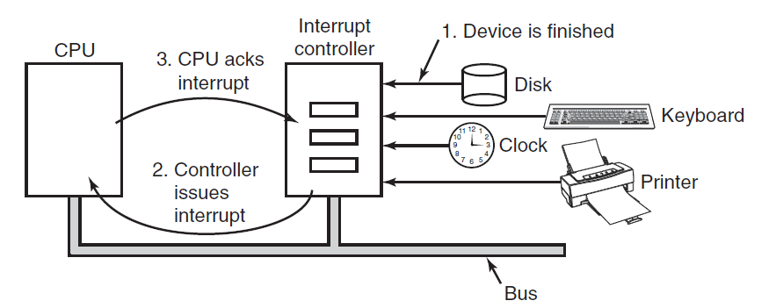
Interrupts Revisited
Figure 6-6. How an interrupt happens. The connections between the devices and the controller actually use interrupt lines on the bus rather than dedicated wires.

Slide 14
An alternative scheme for dealing with I/O is the interrupt-driven method. An interrupt is a signal to the microprocessor from a device that requires attention.
A device controller puts an interrupt signal on the bus when it needs CPU’s attention when CPU receives an interrupt, It saves its current state and invokes the appropriate interrupt handler using the interrupt vector (addresses of OS routines to handle various events). When the interrupting device has been dealt with, the CPU continues with its original task as if it had never been interrupted.

Slide 15
Principles of I/O Software
Goals of the I/O Software
A key concept in the design of I/O software is known as device independence.
Device independence is the goal of uniform naming. The name of a file or a device should simply be a string or an integer and not depend on the device in any way.
issue for I/O software :
Error handling.
Synchronous (blocking) vs. asynchronous (interrupt-driven) transfers.
Buffering.
sharable vs. dedicated devices: Some I/O devices, such as disks, can be used by many users at the same time. No problems are caused by multiple users having open files on the same disk at the same time. Other devices, such as printers, have to be dedicated to a single user until that user is finished.

Slide 16
Handling I/O:
Data transfer between the CPU and I/O devices can be done in variety of modes.
Programmed I/O:
In this mode the data transfer is initiated by the instructions written in a computer program. An input instruction is required to store the data from the device to the CPU and a store instruction is required to transfer the data from the CPU to the device.
Data transfer through this mode requires constant monitoring of the peripheral device by the CPU and also monitor the possibility of new transfer once the transfer has been initiated. Thus CPU stays in a loop until the I/O device indicates that it is ready for data transfer. Thus programmed I/O is a time consuming process that keeps the processor busy needlessly and leads to wastage of the CPU cycles.

Slide 17
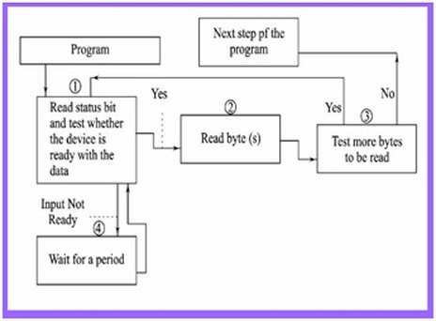
Programmed I/O Mode Input Data Transfer

Slide 18
Programmed I/O Mode Input Data Transfer
Each input is read after first testing whether the device is ready with the input (a state reflected by a bit in a status register).
The program waits for the ready status by repeatedly testing the status bit and till all targeted bytes are read from the input device.
The program is in busy (non-waiting) state only after the device gets ready else in wait state.

Slide 19
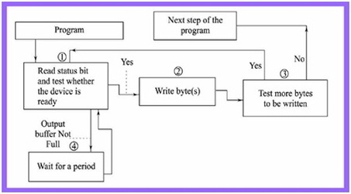
Programmed I/O Mode Output Data Transfer
Each output written after first testing whether the device is ready to accept the byte at its output register or output buffer is empty.
The program waits for the ready status by repeatedly testing the status bit(s) and till all the targeted bytes are written to the device.
The program in busy (non-waiting) state only after the device gets ready else wait state.

Slide 20
I/O using DMA
Disadvantage of interrupt-driven I/O is that an interrupt occurs on every character. Interrupts take time, so this scheme wastes a certain amount of CPU time. A solution is to use DMA.
DMA is programmed I/O, only with the DMA controller doing all the work, instead of the main CPU. This strategy requires special hardware (the DMA controller) but frees up the CPU during the I/O to do other work.

Slide 21
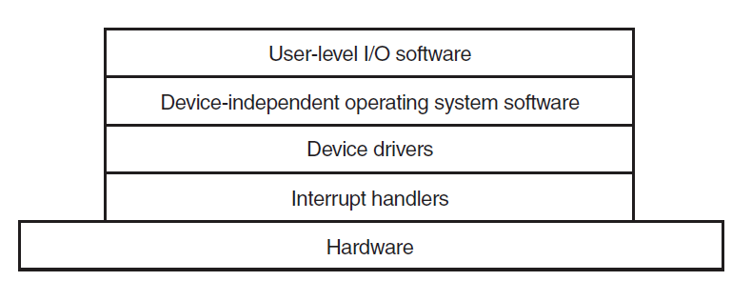
I/O Software layers
I/O software is typically organized in four layers, as shown in Fig. 5-11. Each layer has a well-defined function to perform and a well-defined interface to the adjacent layers.
Figure 6-12. Layers of the I/O software system.

Slide 22
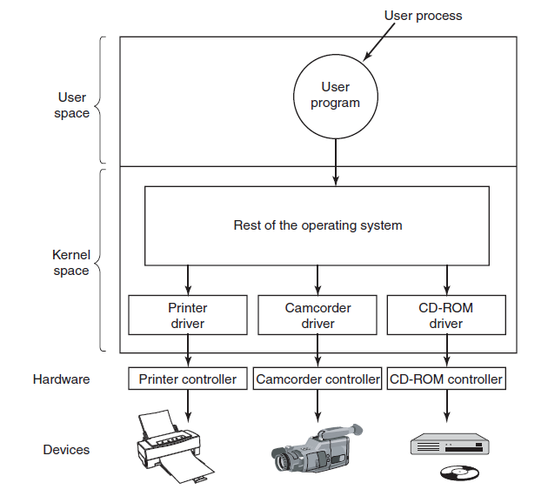
Device Drivers
Figure 6-13. Logical positioning of device drivers. In reality all communication between drivers and device controllers goes over the bus.

Slide 23
A device driver is a piece of software that allows your computer's operating system to communicate with a hardware device the driver is written for. Generally, a driver communicates with the device through the computer bus, which connects the device with the computer. Device Drivers depend upon the Operating System's instruction to access the device and performing any particular action. After the action, they also show their reactions by delivering output or message from the hardware device to the Operating system.

Slide 24
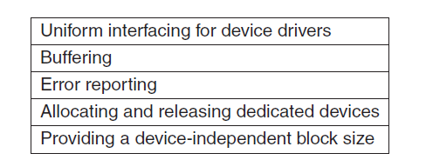
Device-Independent I/O Software
Figure 6-14. Functions of the device-independent I/O software.

Slide 25
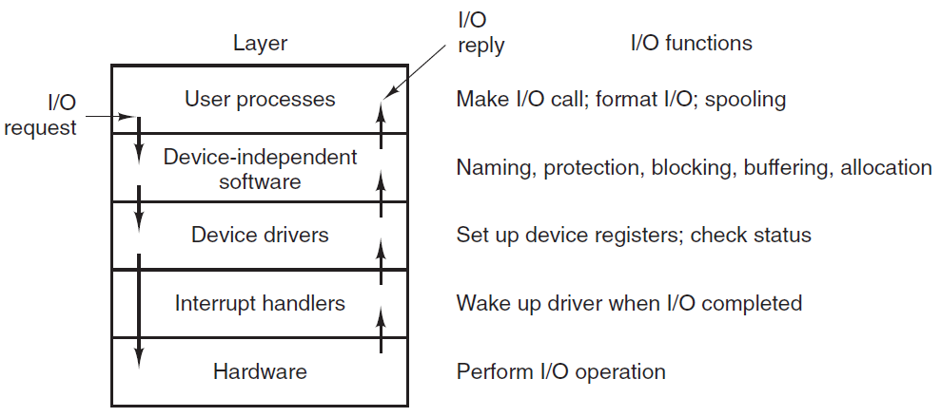
User-Space I/O Software
Figure 6-15. Layers of the I/O system and the main functions of each layer.

Slide 26
Disks
Disk Hardware
Disks come in a variety of types. The most common ones are the magnetic hard disks. They are characterized by the fact that reads and writes are equally fast, which makes them suitable as secondary memory (paging, file systems, etc.).
For distribution of programs, data, and movies, optical disks (DVDs and Blu-ray) are also important.

Slide 27
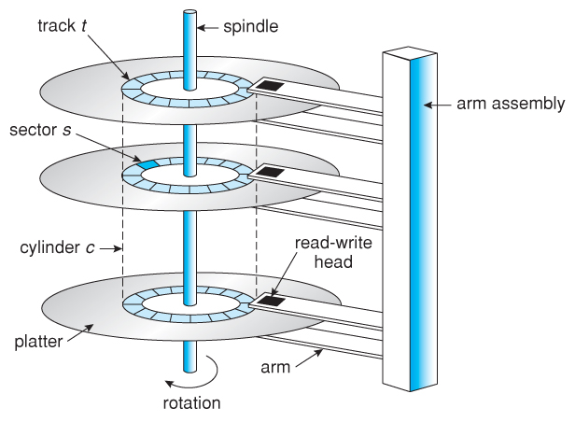

Slide 28
Seek time – The time taken by the R-W head to reach the desired track from its current position.
Rotational latency – Time is taken by the sector to come under the R-W head.
Data transfer time – Time is taken to transfer the required amount of data. It depends upon the rotational speed.
Controller time – The processing time taken by the controller.
Average Access time – seek time + Average Rotational latency + data transfer time + controller time.

Slide 29
Disk Arm Scheduling Algorithms
How long it takes to read or write a disk block. The time required is determined by three factors:
1. Seek time (the time to move the arm to the proper cylinder).
2. Rotational delay (how long for the proper sector to appear under the reading head).
3. Actual data transfer time.

Slide 30
Disk Scheduling Algorithms
FCFS Algorithm
SSTF Algorithm
SCAN Algorithm
C-SCAN Algorithm
LOOK Algorithm
C-LOOK Algorithm

Slide 31
FCFS Scheduling
It stands first-come first-served
Simplest
It services the IO requests in the order in which they arrive
No starvation: every request is serviced
Doesn’t provide fastest service: does not optimize the seek time.
The request may come from different processes therefore there is the possibility of inappropriate movement of the head.

Slide 32
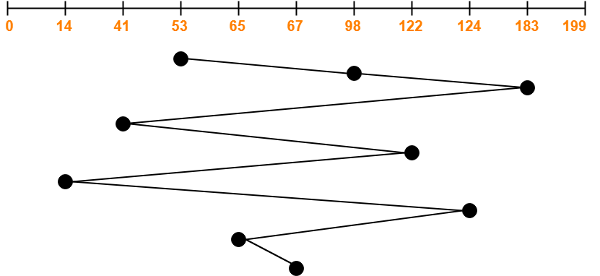
Q. A disk contains 200 cylinders ,the track sequence is 98, 183, 41, 122, 14, 124, 65, 67 and current position of R/W head is 53 calculate total no of arm movement of head.
Total head movements incurred while servicing these requests
= (98 – 53) + (183 – 98) + (183 – 41) + (122 – 41) + (122 – 14) + (124 – 14) + (124 – 65) + (67 – 65)= 45 + 85 + 142 + 81 + 108 + 110 + 59 + 2
= 632

Slide 33
SSTF Scheduling
SSTF stands for Shortest Seek Time First.
This algorithm services that request next which requires least number of head movements from its current position regardless of the direction.
It breaks the tie in the direction of head movement.
Advantages:
It reduces the total seek time as compared to FCFS.
It provides increased throughput.
It provides less average response time and waiting time.
Disadvantages:
There is an overhead of finding out the closest request.
The requests which are far from the head might starve for the CPU.
It provides high variance in response time and waiting time.
Switching the direction of head frequently slows down the algorithm.

Slide 34
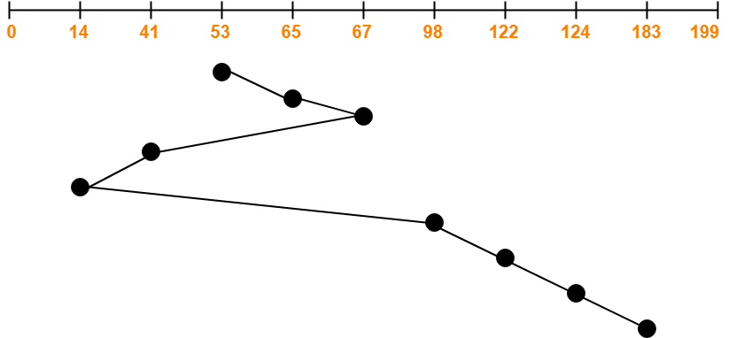
Q. Suppose that a disk drive has the cylinder numbered from 0 to 199. The head is currently at cylinder number 53. The queue for services of cylinder is as 98, 183, 41, 122, 14, 124, 65, and 67. What is the total head movement in each of the following disk algorithm to satisfy the requests?
Total head movements incurred while servicing these requests
= (65 – 53) + (67 – 65) + (67 – 41) + (41 – 14) + (98 – 14) + (122 – 98) + (124 – 122) + (183 – 124)= 12 + 2 + 26 + 27 + 84 + 24 + 2 + 59
= 236

Slide 35
SCAN/Elevator Scheduling
Also called the elevator algorithm.
This algorithm scans all the cylinders of the disk back and forth.
The disk arm moves into a particular direction till the end, satisfying all the requests coming in its path and then it turns back and moves in the reverse direction satisfying requests coming in its path.
It works in the way an elevator works, elevator moves in a direction completely till the last floor of that direction and then turns back.
High throughput
Low variance of response time
Average response time
Long waiting time for requests for locations just visited by disk arm

Slide 36
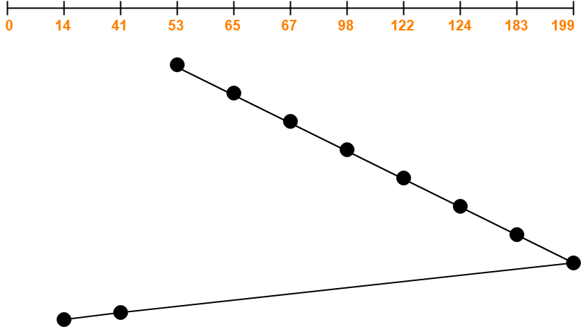
Q. Consider a disk queue with requests for I/O to blocks on cylinders 98, 183, 41, 122, 14, 124, 65, 67. The head is initially at cylinder number 53 moving towards larger cylinder numbers on its servicing pass. The cylinders are numbered from 0 to 199.
Total head movements incurred while servicing these requests = (65 – 53) + (67 – 65) + (98 – 67) + (122 – 98) + (124 – 122) + (183 – 124) + (199 – 183) + (199 – 41) + (41 – 14) = 12 + 2 + 31 + 24 + 2 + 59 + 16 + 158 + 27
= 331

Slide 37
C-SCAN Scheduling
Circular-SCAN Algorithm is an improved version of the SCAN Algorithm.
Head starts from one end of the disk and move towards the other end servicing all the requests in between.
After reaching the other end, head reverses its direction.
It then returns to the starting end without servicing any request in between. The same process repeats.
Advantages:
The waiting time for the cylinders just visited by the head is reduced as compared to the SCAN Algorithm.
It provides uniform waiting time.
It provides better response time.
Disadvantages:
It causes more seek movements as compared to SCAN Algorithm.
It causes the head to move till the end of the disk even if there are no requests to be serviced.

Slide 38
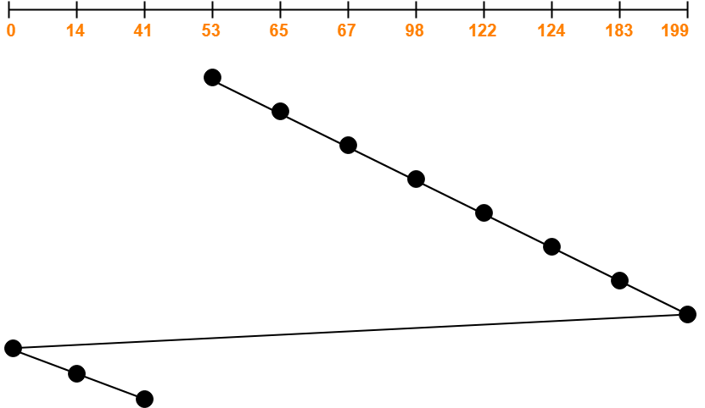
Q. Suppose that a disk drive has the cylinder numbered from 0 to 199. The head is currently at cylinder number 53 moving towards larger cylinder numbers on its servicing pass. The queue for services of cylinder is as 98, 183, 41, 122, 14, 124, 65 and 67. What is the total head movement in each of the following disk algorithm to satisfy the requests?
Total head movements incurred while servicing these requests
= (65 – 53) + (67 – 65) + (98 – 67) + (122 – 98) + (124 – 122) + (183 – 124) + (199 –183) + (199 – 0) + (14 – 0) + (41 – 14)
= 12 + 2 + 31 + 24 + 2 + 59 + 16 + 199 + 14 + 27
= 386

Slide 39
LOOK Scheduling
LOOK Algorithm is an improved version of the SCAN Algorithm.
Head starts from the first request at one end of the disk and moves towards the last request at the other end servicing all the requests in between.
After reaching the last request at the other end, head reverses its direction.
It then returns to the first request at the starting end servicing all the requests in between.
The same process repeats.
Advantages:
It does not causes the head to move till the ends of the disk when there are no requests to be serviced.
It provides better performance as compared to SCAN Algorithm.
It does not lead to starvation.
It provides low variance in response time and waiting time.
Disadvantages:
There is an overhead of finding the end requests.
It causes long waiting time for the cylinders just visited by the head.

Slide 40
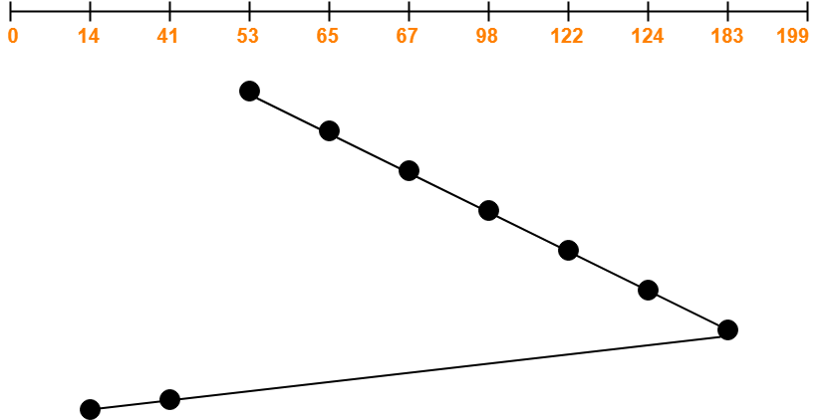
Q. Consider a disk queue with requests for I/O to blocks on cylinders 98, 183, 41, 122, 14, 124, 65, 67. The head is initially at cylinder number 53 moving towards larger cylinder numbers on its servicing pass. The cylinders are numbered from 0 to 199.
Total head movements incurred while servicing these requests
= (183 – 53) + (183 – 14)
= 130 + 169
= 299

Slide 41
C-LOOK Scheduling
Circular-LOOK Algorithm is an improved version of the LOOK Algorithm.
Head starts from the first request at one end of the disk and moves towards the last request at the other end servicing all the requests in between.
After reaching the last request at the other end, head reverses its direction.
It then returns to the first request at the starting end without servicing any request in between.
The same process repeats.
Advantages:
It does not causes the head to move till the ends of the disk when there are no requests to be serviced.
It reduces the waiting time for the cylinders just visited by the head.
It provides better performance as compared to LOOK Algorithm.
It does not lead to starvation.
It provides low variance in response time and waiting time.
Disadvantages:
There is an overhead of finding the end requests.

Slide 42
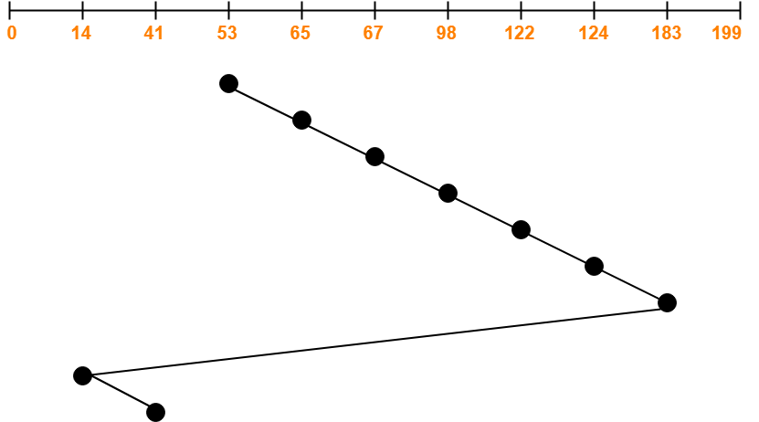
Q. Consider a disk queue with requests for I/O to blocks on cylinders 98, 183, 41, 122, 14, 124, 65, 67. The head is initially at cylinder number 53 moving towards larger cylinder numbers on its servicing pass. The cylinders are numbered from 0 to 199.
Total head movements incurred while servicing these requests
= (183 – 53) + (183 – 14) + (41 – 14)
= 130 + 169 + 27
= 326

Slide 43
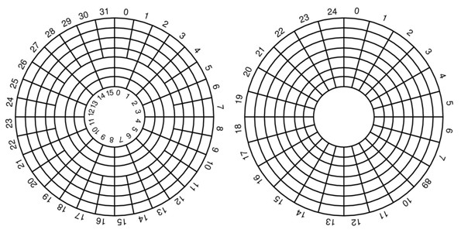
Disk hardware

Slide 44
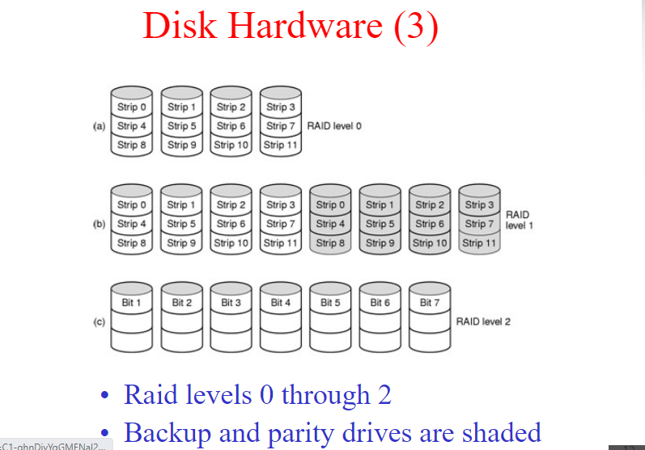
RAID (redundant array of independent disks)

Slide 45
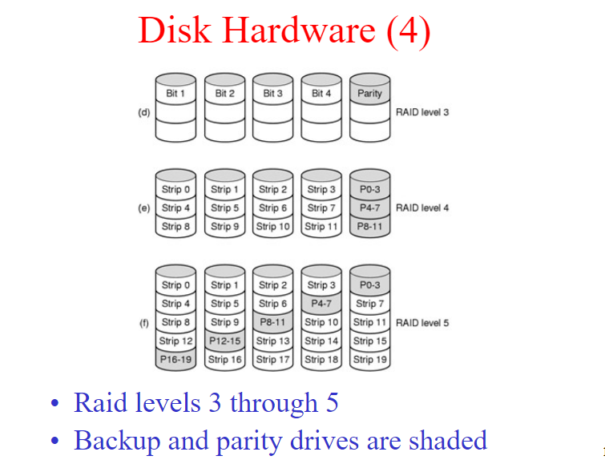
Disk hardware

